Slide 1
The CRA Curse: React Frameworks and Selling Your Soul to Dependency Hell
Michael Keay (UP944342)
What price are you willing to pay for abstraction?
See more: github.com/mwkeay/the-cra-curse
Slide 1 of 31
Notes:
What price are you willing to pay for abstraction?
As programmers, we are all seeking shortcuts. “Work smarter, not harder” sometimes feels like the tagline of computing.
And why not? Simplifying tasks is arguably the core principle of what we do. The goal of software. So, where do we draw the line? At what point are we giving up too much responsibility

Slide 2

The CRA Curse: React Frameworks and Selling Your Soul to Dependency Hell
Michael Keay (UP944342)
Create React App
See more: github.com/mwkeay/the-cra-curse
Slide 2 of 31
Notes:
Today I am going to talk about why this here is one of those points.
I imagine most of you have heard of this tool. Some of you, like me, have probably used it.
But before I get ahead of myself, …

Slide 3
The CRA Curse: React Frameworks and Selling Your Soul to Dependency Hell
Michael Keay (UP944342)
Create React App
See more: github.com/mwkeay/the-cra-curse
Slide 3 of 31
Notes:
Let’s quickly go over React.

Slide 4

The CRA Curse: React Frameworks and Selling Your Soul to Dependency Hell
Michael Keay (UP944342)
See more: github.com/mwkeay/the-cra-curse
Slide 3 of 31
Notes:
React is the most popular JavaScript library for building user interfaces.

Slide 5




The CRA Curse: React Frameworks and Selling Your Soul to Dependency Hell
Michael Keay (UP944342)
See more: github.com/mwkeay/the-cra-curse
Slide 4 of 31
Notes:
React is more widely adopted than ever, with major sites like Netflix and Spotify built using React …

Slide 6


The CRA Curse: React Frameworks and Selling Your Soul to Dependency Hell
Michael Keay (UP944342)
See more: github.com/mwkeay/the-cra-curse
Slide 5 of 31
Notes:
React combines script and markup into a single file.
Letting us define Javascript variables as, what are essentially, HTML elements.

Slide 7
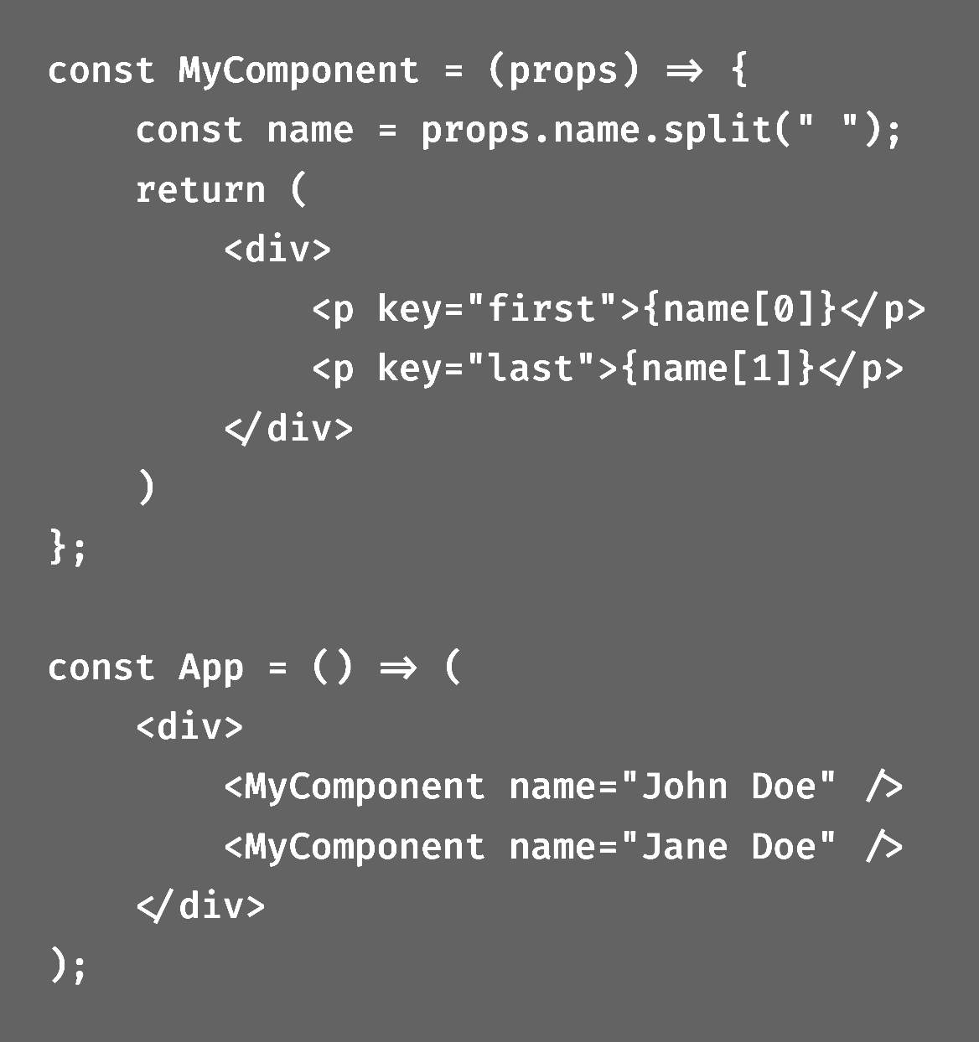
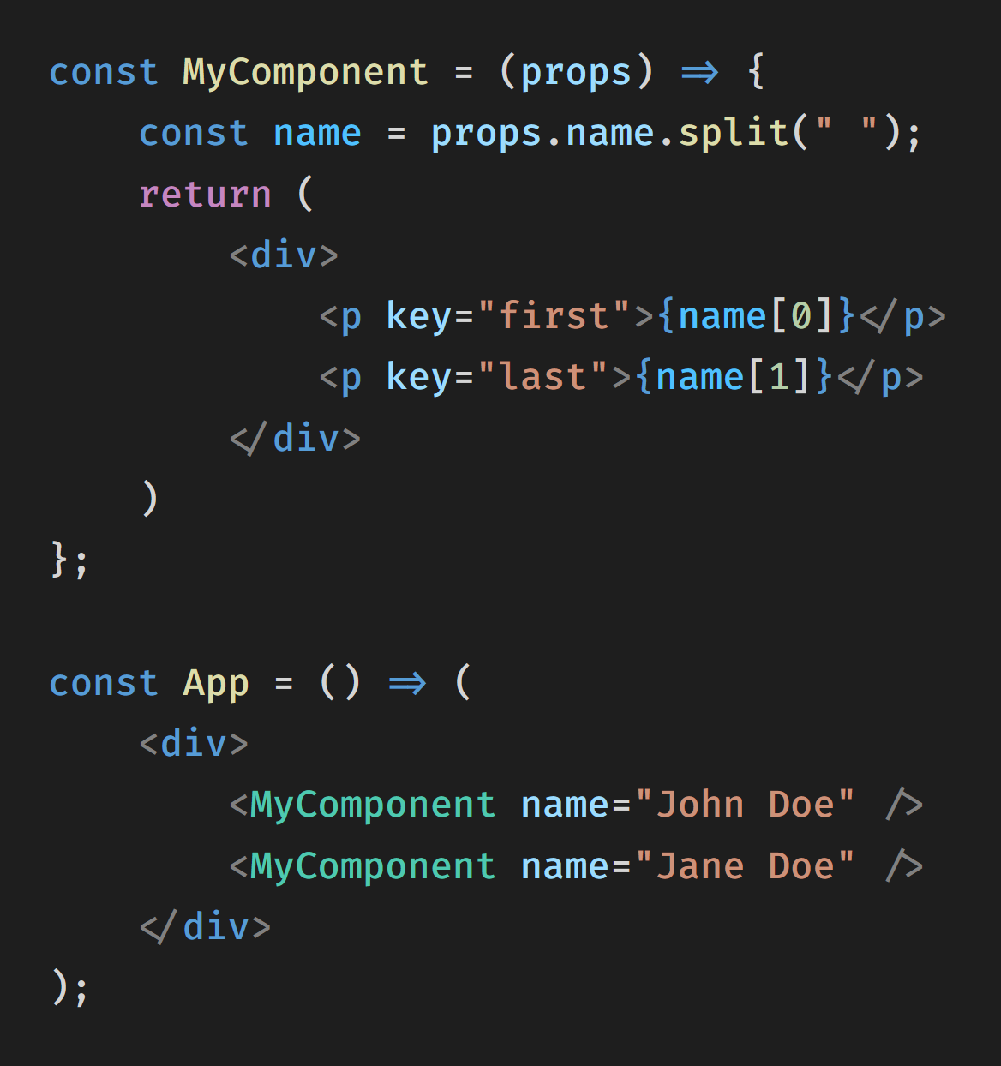
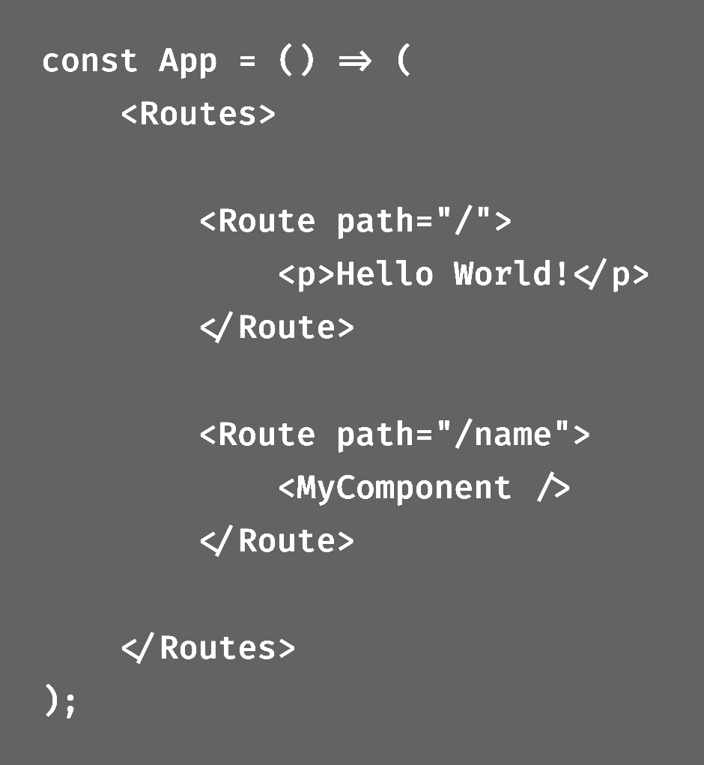
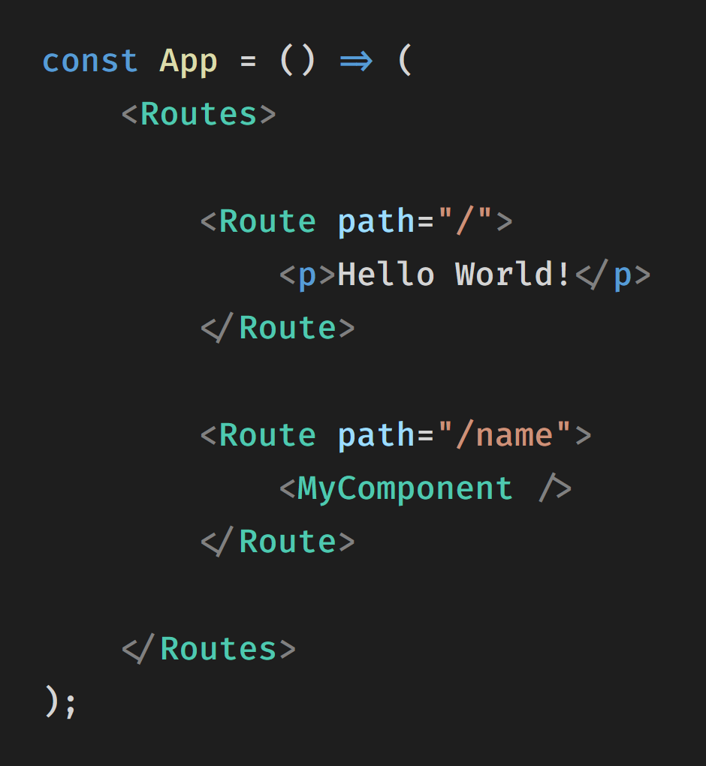
The CRA Curse: React Frameworks and Selling Your Soul to Dependency Hell
Michael Keay (UP944342)
See more: github.com/mwkeay/the-cra-curse
Slide 6 of 31
Notes:
By building and shape our UI entirely in JavaScript,
React allows us to create components that act as our own custom HTML elements.
And has become a cornerstone of developing dynamic and interactive web applications.

Slide 8
The CRA Curse: React Frameworks and Selling Your Soul to Dependency Hell
Michael Keay (UP944342)
<p>{ text }</p>;
<div>
<MyComponent />
<MyComponent />
<MyComponent />
</div>
const MyComponent = () => {
const hello = "Hello World!";
return <p>{ text }</p>;
};
const App = () => {
return (
<div>
<MyComponent />
<MyComponent />
<MyComponent />
</div>
);
};
React.createElement('p', null, hello);
React.createElement('div', null,
React.createElement(MyComponent, null),
React.createElement(MyComponent, null),
React.createElement(MyComponent, null)
const MyComponent = () => {
const hello = "Hello World!";
return React.createElement('p', null, hello);
};
const App = () => {
return React.createElement('div', null,
React.createElement(MyComponent, null),
React.createElement(MyComponent, null),
React.createElement(MyComponent, null)
);
};
. . .
.js
.jsx
See more: github.com/mwkeay/the-cra-curse
Slide 7 of 31

Slide 9
The CRA Curse: React Frameworks and Selling Your Soul to Dependency Hell
Michael Keay (UP944342)
See more: github.com/mwkeay/the-cra-curse
Slide 8 of 31
Notes:
and with over two million developers visiting the React docs every month, it’s become a technology we should all understand in modern web development.
So that’s React, …
… but what do I mean when I say Create React App?
Well, Create React App is a tool made by the React team as a clear way to start using the library.

Slide 10






The CRA Curse: React Frameworks and Selling Your Soul to Dependency Hell
Michael Keay (UP944342)
.babelrc
webpack.config.js
jest.config.js
+
+
See more: github.com/mwkeay/the-cra-curse
Slide 9 of 31
Notes:
If you haven’t guessed it, baking a cake is a metaphor for creating a web application with React.
We have the tools we need to install
How the tools are setup for our application
And the code for our React user interface

Slide 11
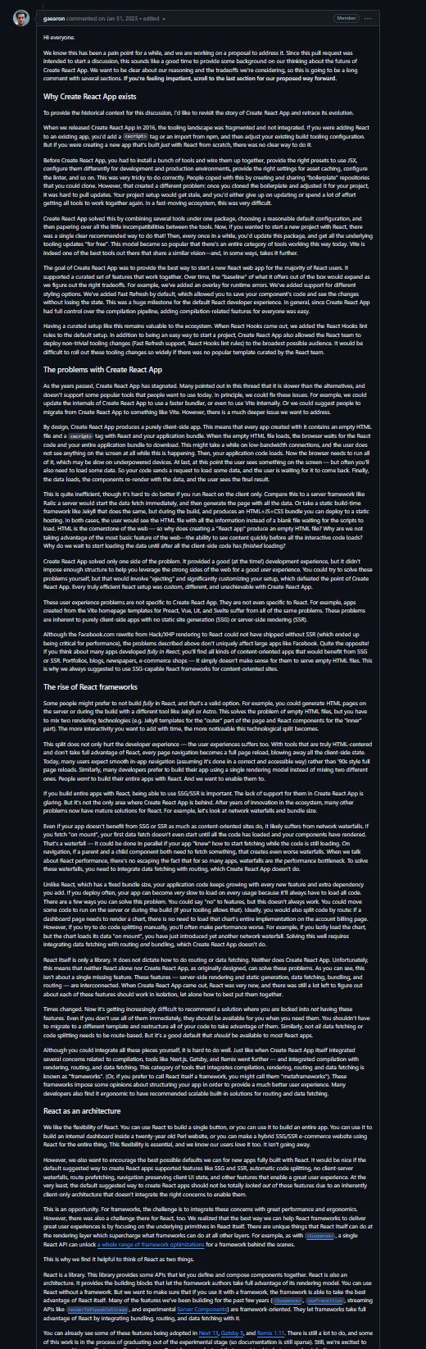
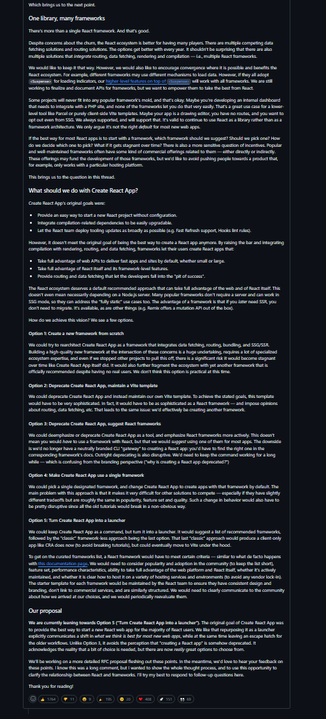

The CRA Curse: React Frameworks and Selling Your Soul to Dependency Hell
Michael Keay (UP944342)
Dan Abramov
https://github.com/reactjs/react.dev/pull/5487
See more: github.com/mwkeay/the-cra-curse
Slide 10 of 31
Notes:
So what does this new application actually do?

Slide 12
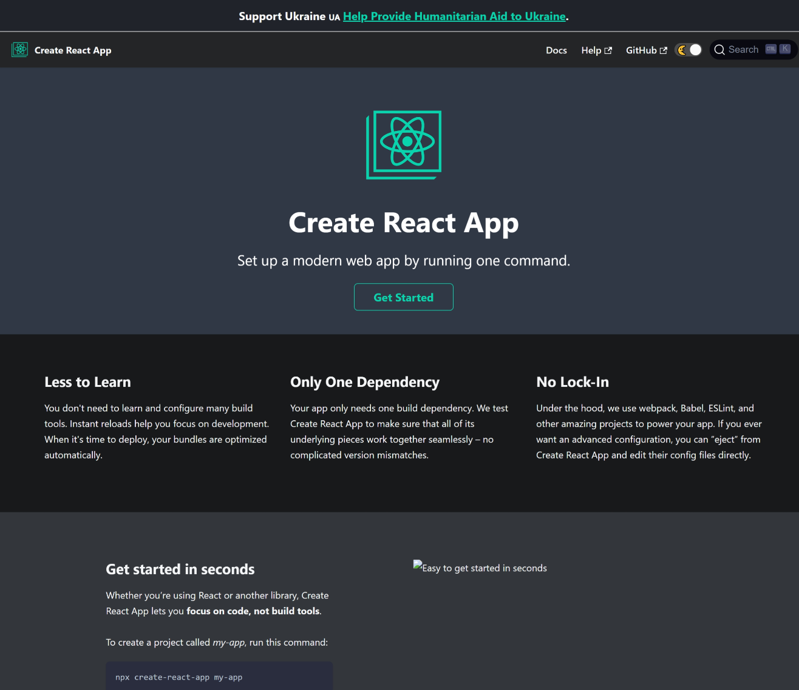
The CRA Curse: React Frameworks and Selling Your Soul to Dependency Hell
Michael Keay (UP944342)
“Set up a modern web app
by running one command.”
$ npx create-react-app
https://create-react-app.dev
See more: github.com/mwkeay/the-cra-curse
Slide 11 of 31
Notes:
It is essentially a template for creating React web applications.
The selling point of using this template is summarised by its tagline:
“Set up a modern web app by running one command.”
THIS is that command.

Slide 13
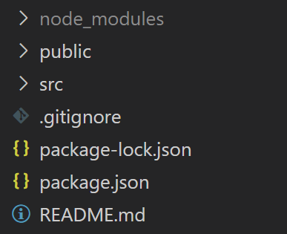
The CRA Curse: React Frameworks and Selling Your Soul to Dependency Hell
Michael Keay (UP944342)
?
$ npm run eject
7 dependencies
No configuration
See more: github.com/mwkeay/the-cra-curse
Slide 12 of 31
Notes:
So what does this new application actually do?

Slide 14
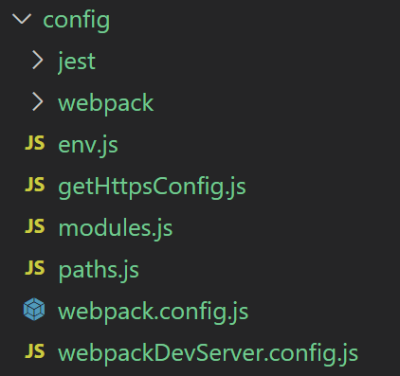
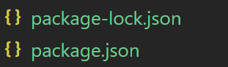
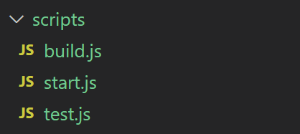
The CRA Curse: React Frameworks and Selling Your Soul to Dependency Hell
Michael Keay (UP944342)
7 dependencies
No configuration
53 dependencies
1,365 lines of configuration files
See more: github.com/mwkeay/the-cra-curse
Slide 12 of 31
Notes:
So what does this new application actually do?

Slide 15
The CRA Curse: React Frameworks and Selling Your Soul to Dependency Hell
Michael Keay (UP944342)
53 dependencies
1,365 lines of configuration files
235 MB
14 build plugins
30 dependencies
197 lines of configuration files
123 MB
3 build plugins
See more: github.com/mwkeay/the-cra-curse
Slide 13 of 31
Notes:
So what does this new application actually do?

Slide 16
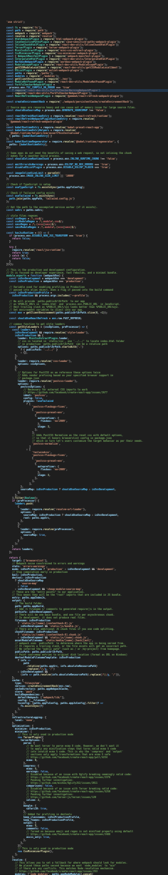
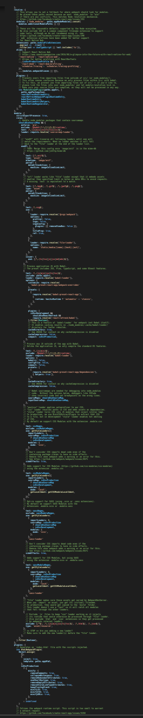
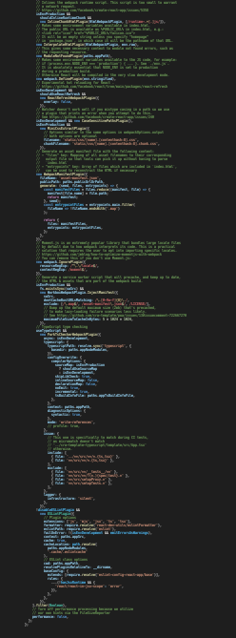
The CRA Curse: React Frameworks and Selling Your Soul to Dependency Hell
Michael Keay (UP944342)
webpack.config.js
(756 lines)
See more: github.com/mwkeay/the-cra-curse
Slide 14 of 31

Slide 17
The CRA Curse: React Frameworks and Selling Your Soul to Dependency Hell
Michael Keay (UP944342)
See more: github.com/mwkeay/the-cra-curse
Slide 15 of 31
Notes:
So what does this new application actually do?

Slide 18
The CRA Curse: React Frameworks and Selling Your Soul to Dependency Hell
Michael Keay (UP944342)
What’s the alternative?
See more: github.com/mwkeay/the-cra-curse
Slide 16 of 31

Slide 19

The CRA Curse: React Frameworks and Selling Your Soul to Dependency Hell
Michael Keay (UP944342)
What’s the alternative?
See more: github.com/mwkeay/the-cra-curse
Slide 17 of 31

Slide 20

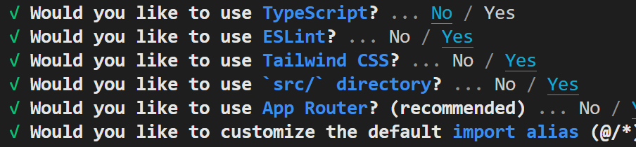
The CRA Curse: React Frameworks and Selling Your Soul to Dependency Hell
Michael Keay (UP944342)
Create New App
Add to Existing App
$ npx create-next-app
$ npm install -D next
package.json
"private": true,
"scripts": {
"dev": "next dev",
"build": "next build",
"start": "next start",
"lint": "next lint"
},
"dependencies": {
See more: github.com/mwkeay/the-cra-curse
Slide 18 of 31

Slide 21


The CRA Curse: React Frameworks and Selling Your Soul to Dependency Hell
Michael Keay (UP944342)
package.json
package.json
"private": true,
"scripts": {
"dev": "next dev",
"build": "next build",
"start": "next start",
"lint": "next lint"
},
"dependencies": {
"private": true,
"scripts": {
"dev": "next dev --turbo",
"build": "next build",
"start": "next start",
"lint": "next lint"
},
"dependencies": {
See more: github.com/mwkeay/the-cra-curse
Slide 19 of 31

Slide 22

The CRA Curse: React Frameworks and Selling Your Soul to Dependency Hell
Michael Keay (UP944342)
next.config.js
module.exports = {
webpack: (config) => {
config.module.rules.push({
// custom Webpack configurations
})
return config
},
}
See more: github.com/mwkeay/the-cra-curse
Slide 20 of 31

Slide 23

The CRA Curse: React Frameworks and Selling Your Soul to Dependency Hell
Michael Keay (UP944342)
Deploy with
See more: github.com/mwkeay/the-cra-curse
Slide 21 of 31

Slide 24
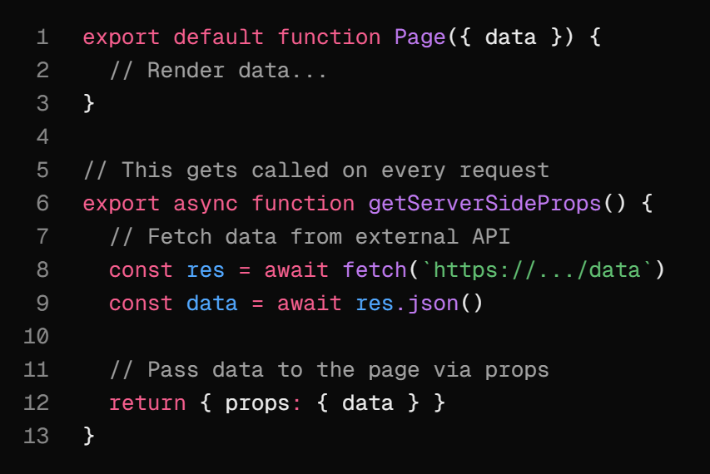
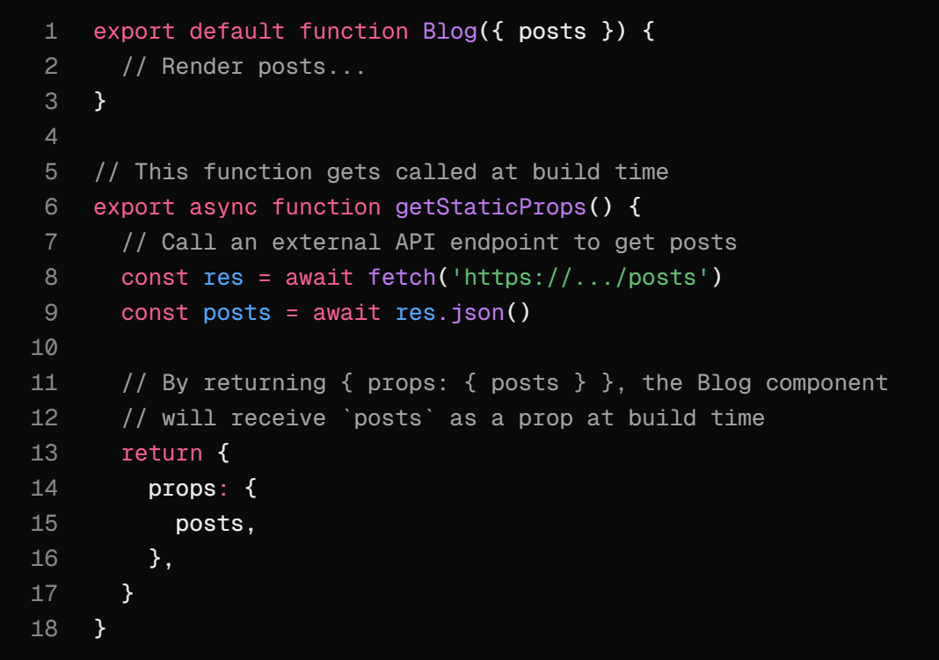
The CRA Curse: React Frameworks and Selling Your Soul to Dependency Hell
Michael Keay (UP944342)
Server-Side Rendering and Static Site Generation
Next.js Docs - Server Side Rendering
Next.js Docs - Static Site Generation
See more: github.com/mwkeay/the-cra-curse
Slide 22 of 31

Slide 25
The CRA Curse: React Frameworks and Selling Your Soul to Dependency Hell
Michael Keay (UP944342)
See more: github.com/mwkeay/the-cra-curse
Slide 23 of 31

Slide 26
The CRA Curse: React Frameworks and Selling Your Soul to Dependency Hell
Michael Keay (UP944342)
$ npm init
See more: github.com/mwkeay/the-cra-curse
Slide 24 of 31

Slide 27

The CRA Curse: React Frameworks and Selling Your Soul to Dependency Hell
Michael Keay (UP944342)
eslint.config.js
jest.config.js
export default [
{
rules: {
semi: "error",
"prefer-const": "error"
}
}
];
export default {
verbose: true,
};
See more: github.com/mwkeay/the-cra-curse
Slide 25 of 31

Slide 28
The CRA Curse: React Frameworks and Selling Your Soul to Dependency Hell
Michael Keay (UP944342)
webpack.config.js
(756 lines)
See more: github.com/mwkeay/the-cra-curse
Slide 26 of 31

Slide 29
The CRA Curse: React Frameworks and Selling Your Soul to Dependency Hell
Michael Keay (UP944342)
webpack.common.js
webpack.dev.js
webpack.production.js
/**
* ===============
* Modules
* ===============
*/
const path = require("path");
// Webpack plugin to use hashed filenames in `index.html`
const HtmlWebpackPlugin = require("html-webpack-plugin");
/**
* =====================
* Configuration
* =====================
*/
// Common configuration
const common = {
// Entry point for running the application
entry: "./src/index.js",
// Output configuration
output: {
// Specify distributable folder
path: path.resolve(__dirname, "dist"),
// Add hash to filename to avoid cached `main.js` errors
filename: "main.[contenthash].js",
},
// Set to use Webpack's environment specific additions.
// Read more in Webpack's docs: https://webpack.js.org/concepts/targets/.
target: "web",
// Specify file types to resolve
resolve: {
extensions: [".js", ".jsx", ".json"],
},
module: {
rules: [
{
// Babel loader for JavaScript and JSX files
test: /\.(js|jsx)$/,
exclude: /node_modules/,
use: "babel-loader",
},
{
// CSS loader for CSS files
test: /\.css$/,
use: [
"style-loader",
"css-loader",
],
},
],
},
plugins: [
// Replaces "main.js" with "main.[contenthash].js" in index.html
new HtmlWebpackPlugin({
template: path.resolve(__dirname, "public", "index.html"),
}),
],
};
// Export
module.exports = common;
/**
* ===============
* Modules
* ===============
*/
const path = require("path");
// Function to merge production config with base config
const { merge } = require("webpack-merge");
// Webpack plugin to add static files from `./public` to build
const CopyPlugin = require("copy-webpack-plugin");
// Base config
const common = require("./webpack.common.js");
/**
* =====================
* Configuration
* =====================
*/
// Production configuration
const prod = {
mode: "production",
// Source maps link minified build code to the original source code for debugging.
// "hidden-source-map" hides source maps from end-users, also reducing bundle size.
// Note: For debugging production errors, consider using "source-map" instead to ma
devtool: "hidden-source-map",
plugins: [
// Webpack plugin to add static files from `./public` to build
new CopyPlugin({
patterns: [
{
// Copy statis files from the public directory
from: "public",
// Paste static files in a new directory inside the distributable
to: "./static",
// Ignores index.html as HtmlWebpackPlugin handles index.html
globOptions: { ignore: ["**/index.html"] },
// Stops errors when public folder has only index.html
noErrorOnMissing: true
},
],
}),
],
};
// Merge production config with base config
const merged = merge(common, prod);
// Export merged config
module.exports = merged
/**
* ===============
* Modules
* ===============
*/
// Function to merge development config with base config
const { merge } = require("webpack-merge");
// Base config
const common = require("./webpack.common.js");
/**
* =====================
* Configuration
* =====================
*/
// Development configuration
const dev = {
mode: "development",
// Source maps link minified build code to the original source code for debugging.
// "eval-source-map" offers a balance of build performance and debuggability, ideal fo
devtool: "eval-source-map",
// Development server configuration
devServer: {
// Server port number (e.g. "3000" serves client at http://localhost:3000)
port: "3000",
// Serve static files from "./public"
static: ["./public"],
// Prevents automatically opening the client in browser.
// Note: Change to `true` for default behaviour.
open: false,
// Enables Hot Module Replacement (live reloads without a full page refresh)
hot: true,
// Enables automatic reloading of the page when changes are made to the source code
liveReload: true,
},
};
// Merge development config with base config
const merged = merge(common, dev);
// Export merged config
module.exports = merged;
65 lines, 1 plugin
55 lines
77 lines, 1 plugin
See more: github.com/mwkeay/the-cra-curse
Slide 27 of 31

Slide 30



The CRA Curse: React Frameworks and Selling Your Soul to Dependency Hell
Michael Keay (UP944342)
See more: github.com/mwkeay/the-cra-curse
Slide 28 of 31

Slide 31
The CRA Curse: React Frameworks and Selling Your Soul to Dependency Hell
Michael Keay (UP944342)
$ npm install -D vite @vitejs/plugin-react-refresh
vite.config.js
package.json
import { defineConfig } from “vite”
import reactRefresh from “@vitejs/plugin-react-refresh”
export default defineConfig({
plugins: [reactRefresh()]
})
"private": true,
"scripts": {
"dev": "vite dev",
"build": "vite build"
},
"dependencies": {
See more: github.com/mwkeay/the-cra-curse
Slide 29 of 31

Slide 32
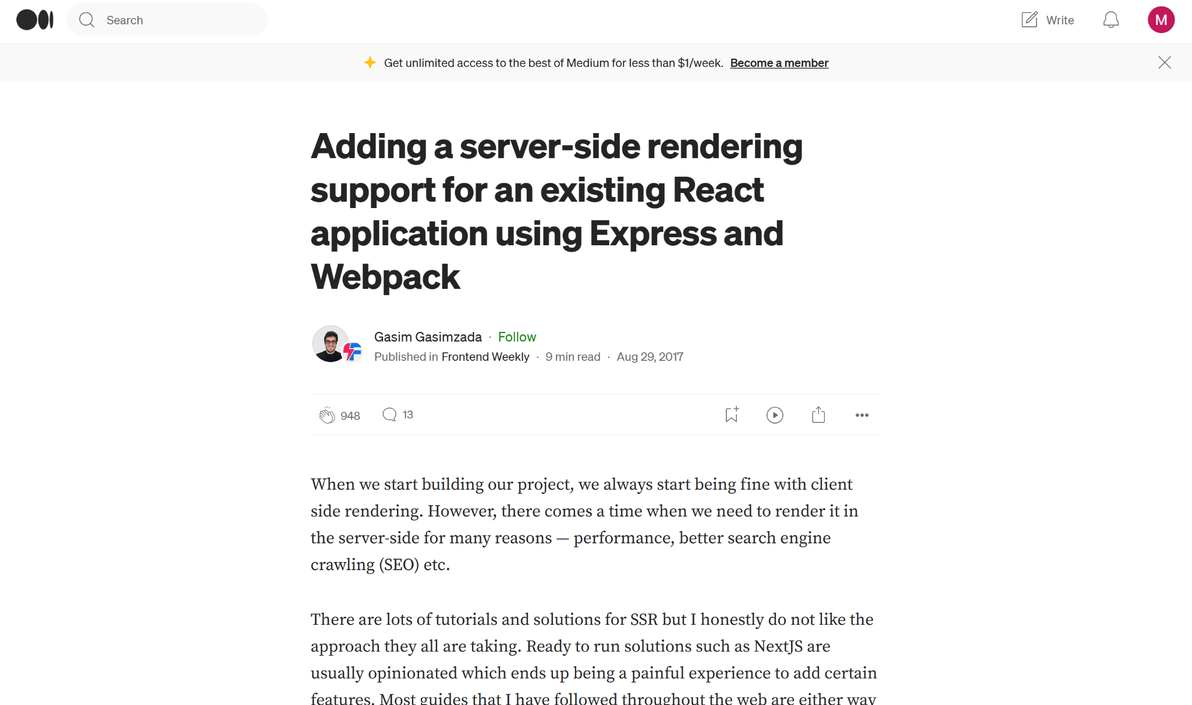
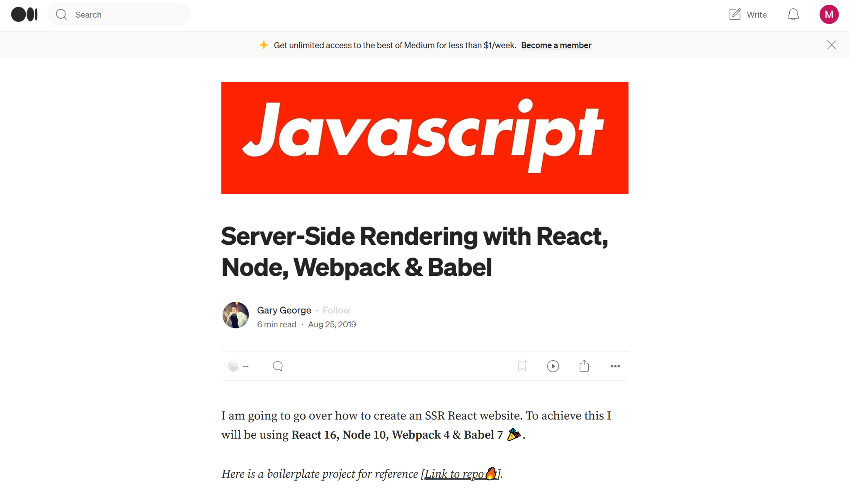
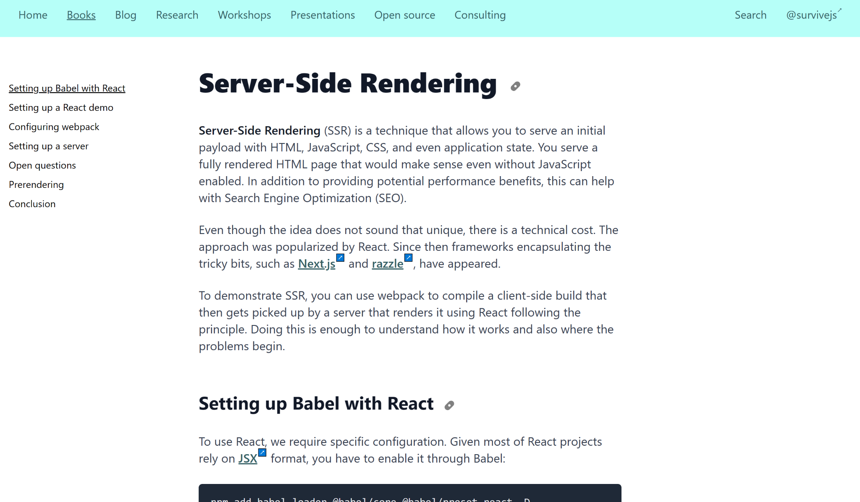
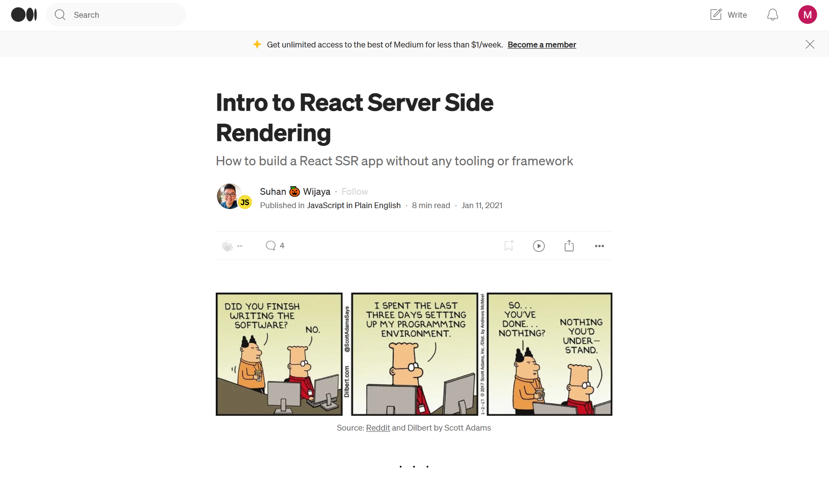
The CRA Curse: React Frameworks and Selling Your Soul to Dependency Hell
Michael Keay (UP944342)
See more: github.com/mwkeay/the-cra-curse
Slide 30 of 31

Slide 33

The CRA Curse: React Frameworks and Selling Your Soul to Dependency Hell
Michael Keay (UP944342)
github.com/mwkeay/the-cra-curse
(This repository will go public as of Friday 17th May)
See more: github.com/mwkeay/the-cra-curse
Slide 31 of 31

